Slide 1
Distributed Systems
Processes

Slide 2
Outlines
Process
Thread
Client-server
Code-migration

Slide 3
Introduction
Communication takes place between processes
A process is a program in execution
From OS perspective, management and scheduling of processes is important
Other important issues arise in distributed systems
multithreading to enhance performance
how are clients and servers organized
process or code migration to achieve scalability and to dynamically configure clients and servers
software agents: a collection of processes trying to reach a common goal

Slide 4
Threads and their Implementation
threads can be used in both distributed and nondistributed systems
Threads in Nondistributed Systems
a process has an address space (containing program text and data) and a single thread of control, as well as other resources such as open files, child processes, accounting information, etc.
threads allow multiple executions to take place in the same process environment, called multithreading

Slide 5
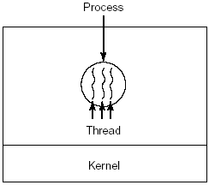
three processes each with one thread
one process with three threads

Slide 6
Cont.----
each thread has its own program counter, registers, stack, and state;
but all threads of a process share address space, global variables and other resources such as open files, etc.

Slide 7
Threads take turns in running
Thread Usage – Why do we need threads?
e.g., a wordprocessor has different parts; parts for
interacting with the user
formatting the page as soon as changes are made
timed savings (for auto recovery)
spelling and grammar checking
etc.
1. Simplifying the programming model: since many activities are going on at once
2. They are easier to create and destroy than processes since they do not have any resources attached to them
3. Performance improves by overlapping activities if there is too much I/O; i.e., to avoid blocking when waiting for input or doing calculations, say in a spreadsheet
4. Real parallelism is possible in a multiprocessor system

Slide 8
Having finer granularity in terms of multiple threads per process rather than processes provides better performance and makes it easier to build distributed applications
In nondistributed systems, threads can be used with shared data instead of processes to avoid context switching overhead in interprocess communication (IPC)
context switching as the result of IPC

Slide 9
Cont---
Threads are usually provided in the form of a thread package
The package contains operations to create and destroy a thread, operations on synchronization variables such as mutexes and condition variables
two approaches of constructing a thread package
construct a thread library that is executed entirely in user mode (the OS is not aware of threads)
cheap to create and destroy threads; just allocate and free memory
context switching can be done using few instructions; store and reload only CPU register values
disadv: invocation of a blocking system call will block the entire process to which the thread belongs and all other threads in that process

Slide 10
Cont---
2. Implement them in the OS’s kernel
let the kernel be aware of threads and schedule them
expensive for thread operations such as creation and deletion since each requires a system call

Slide 11
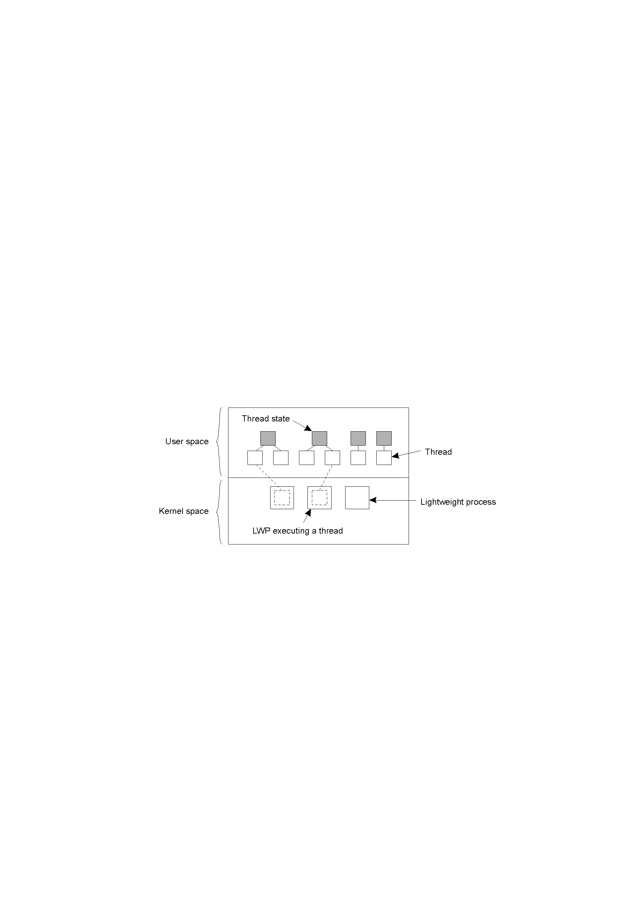
Cont---
Solution: use a hybrid form of user-level and kernel-level threads, called lightweight process (LWP)
A LWP runs in the context of a single (heavy-weight) process, and there can be several LWPs per process
The system also offers a user-level thread package for some operations such as creating and destroying threads, for thread synchronization (mutexes and condition variables)
The thread package can be shared by multiple LWPs
combining kernel-level lightweight processes and user-level threads

Slide 12
Threads in Distributed Systems
Multithreaded Clients
consider a Web browser; fetching different parts of a page can be implemented as a separate thread, each opening its own TCP/IP connection to the server or to separate and replicated servers
each can display the results as it gets its part of the page
Multithreaded Servers
servers can be constructed in three ways
single-threaded process
it gets a request, examines it, carries it out to completion before getting the next request
the server is idle while waiting for disk read, i.e., system calls are blocking

Slide 13
threads
Threads are more important for implementing servers
e.g., a file server
the dispatcher thread reads incoming requests for a file operation from clients and passes it to an idle worker thread
the worker thread performs a blocking disk read; in which case another thread may continue, say the dispatcher or another worker thread

Slide 14
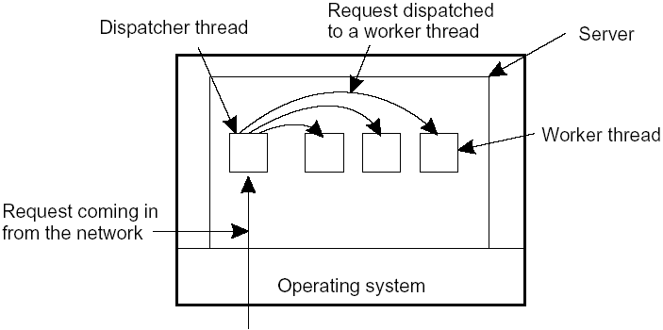
a multithreaded server organized in a dispatcher/worker model

Slide 15
finite-state machine
if threads are not available
it gets a request, examines it, tries to fulfill the request from cache, else sends a request to the file system;
but instead of blocking it records the state of the current request and proceeds to the next request
Summary
Model | Characteristics
Threads | Parallelism, blocking system calls
Single-threaded process | No parallelism, blocking system calls
Finite-state machine | Parallelism, nonblocking system calls
three ways to construct a server

Slide 16
Anatomy of Clients
User Interfaces
to create a convenient environment for the interaction of a human user and a remote server; e.g. mobile phones with simple displays and a set of keys
GUIs are most commonly used
The X Window System (or simply X)
it has the X-kernel: the part of the OS that controls the terminal (monitor, keyboard, pointing device like a mouse)
contains all terminal-specific device drivers through the library called xlib

Slide 17
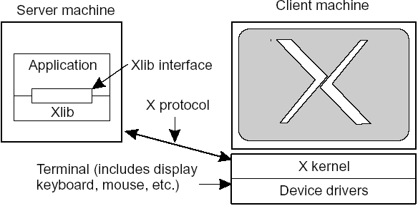
the basic organization of the X Window System

Slide 18
Client-Side Software for Distribution Transparency
In addition to the user interface, parts of the processing and data level in a client-server application are executed at the client side
moreover, client software can also include components to achieve distribution transparency
e.g., replication transparency:
assume a distributed system with remote objects;
the client proxy can send requests to each replica,
collects all responses and pass a single return value to the client application

Slide 19
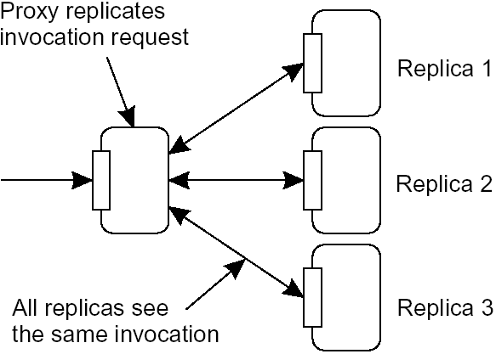
a possible approach to transparent replication of a remote object using a client-side solution

Slide 20
Servers: General Design Issues
Issues
how to organize servers?
where do clients contact a server?
whether and how a server can be interrupted
whether or not the server is stateless
1. how to organize servers?
iterative server
the server itself handles the request and returns the result
concurrent server
it passes a request to a separate process or thread and waits for the next incoming request; e.g., a multithreaded server

Slide 21
where do clients contact a server?
using endpoints or ports at the machine where the server is running where each server listens to a specific endpoint
how do clients know the endpoint of a service?
globally assign endpoints for well-known services; e.g. FTP is on TCP port 21, HTTP is on TCP port 80
for services that do not require pre-assigned endpoints, it can be dynamically assigned by the local OS
how can the client know this endpoint? two approaches
have a daemon running and listening to a well-known endpoint like in DCE(Distributed Computing Environment);
it keeps track of all endpoints of services on the collocated server
the client will first contact the daemon which provides it with the endpoint, and then the client contacts the specific server

Slide 22
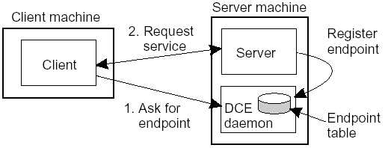
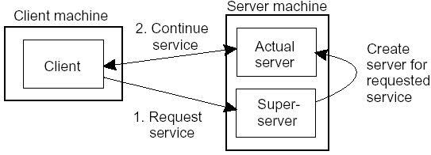
Client-to-server binding using a daemon as in DCE
b. use a superserver (as in UNIX) that listens to all endpoints and then forks a process to take care of the request; this is instead of having a lot of servers running simultaneously and most of them idle
Client-to-Server binding using a superserver as in UNIX

Slide 23
3. whether and how a server can be interrupted
for instance, a user may want to interrupt a file transfer, may be it was the wrong file
let the client exit the client application; this will break the connection to the server; the server will tear down the connection assuming that the client had crashed
or
let the client send out-of-bound data, data to be processed by the server before any other data from the client; the server may listen on a separate control endpoint; or send it on the sane connection as urgent data as is in TCP

Slide 24
4. whether or not the server is stateless
a stateless server does not keep information on the state of its clients; for instance a Web server
a stateful server maintains information about its clients; for instance a file server that allows a client to keep a local copy of a file and can make update operations

Slide 25
Code Migration
So far, communication was concerned on passing data
We may pass programs, even while running and in heterogeneous systems
Code migration also involves moving data as well:
When a program migrates while running, its status, pending signals, and other environment variables such as the stack and the program counter also have to be moved

Slide 26
Reasons for Migrating Code
to improve performance; move processes from heavily-loaded to lightly-loaded machines (load balancing)
to reduce communication: move a client application that performs many database operations to a server if the database resides on the server; then send only results to the client
to exploit parallelism (for nonparallel programs): e.g., copies of a mobile program moving from site to site searching the Web
to have flexibility by dynamically configuring distributed systems:
instead of having a multitiered client-server application deciding in advance which parts of a program are to be run where

Slide 27
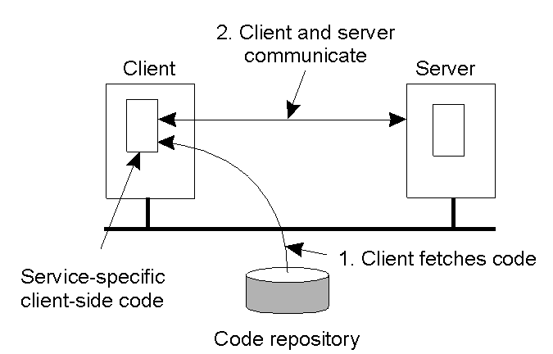
the principle of dynamically configuring a client to communicate to a server; the client first fetches the necessary software, and then invokes the server

Slide 28
Models for Code Migration
a process consists of three segments:
code segment (set of instructions),
resource segment (references to external resources such as files, printers, ...), and
execution segment (to store the current execution state of a process such as private data, the stack, the program counter)
Weak Mobility
transfer only the code segment and may be some initialization data;
in this case a program always starts from its initial stage, e.g. Java Applets
execution can be done by the target process (in its own address space like in Java Applets) or by a separate process

Slide 29
Strong Mobility
transfer code and execution segments; helps to migrate a process in execution
can also be supported by remote cloning; having an exact copy of the original process and running on a different machine; executed in parallel to the original process; UNIX does this by forking a child process
migration can be
sender-initiated: the machine where the code resides or is currently running; e.g., uploading programs to a server; may need authentication or that the client is a registered one
receiver-initiated: by the target machine; e.g., Java Applets; easier to implement

Slide 30
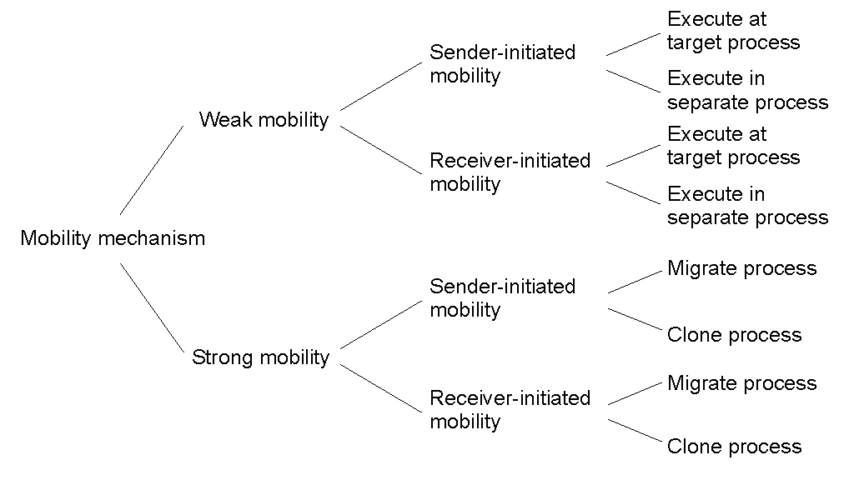
Summary of models of code migration
alternatives for code migration

Slide 31
Migration and Local Resources
how to migrate the resource segment
not always possible to move a resource; e.g., a reference to TCP port held by a process to communicate with other processes
Types of Process-to-Resource Bindings
Binding by identifier (the strongest): a resource is referred by its identifier; e.g., a URL to refer to a Web page or an FTP server referred by its Internet address
Binding by value (weaker): when only the value of a resource is needed; in this case another resource can provide the same value; e.g., standard libraries of programming languages such as C or Java which are normally locally available, but their location in the file system may vary from site to site
Binding by type (weakest): a process needs a resource of a specific type; reference to local devices, such as monitors, printers, ...

Slide 32
in migrating code, the above bindings cannot change, but the references to resources can
how can a reference be changed? depends whether the resource can be moved along with the code, i.e., resource-to-machine binding
Types of Resource-to-Machine Bindings
Unattached Resources: can be easily moved with the migrating program (such as data files associated with the program)
Fastened Resources: such as local databases and complete Web sites; moving or copying may be possible, but very costly
Fixed Resources: intimately bound to a specific machine or environment such as local devices and cannot be moved
we have nine combinations to consider

Slide 33
Resource-to machine binding
 | Unattached | Fastened | Fixed
By identifier By value By type | MV (or GR) CP (or MV, GR) RB (or GR, CP) | GR (or MV) GR (or CP) RB (or GR, CP) | GR GR RB (or GR)
Process-to-resource binding
actions to be taken with respect to the references to local resources when migrating code to another machine
GR: Establish a global system wide reference
MV: Move the resource
CP: Copy the value of the resource
RB: Rebind process to a locally available resource

Slide 34
Migration in Heterogeneous Systems
distributed systems are constructed on a heterogeneous collection of platforms, each with its own OS and machine architecture
heterogeneity problems are similar to those of portability
easier in some languages; for scripting languages the source code is interpreted; for Java an intermediary code is generated by the compiler for a virtual machine
in weak mobility
since there is no runtime information, compile the source code for each potential platform

Slide 35
in strong mobility
difficult to transfer the execution segment since there may be platform-dependent information such as register values;
one possible solution: restrict migration to specific points in the execution of a program, i.e., only when a subroutine is called
the runtime system maintains a machine-independent program stack, called migration stack; for this the compiler must generate code to update the migration stack whenever a subroutine is entered or exited

Slide 36
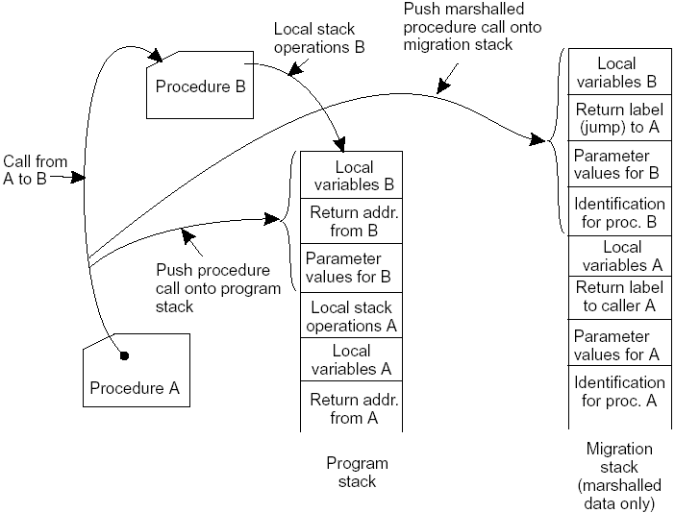
the principle of maintaining a migration stack to support migration of an execution segment in a heterogeneous environment

